Slide 1
Experiment No.3 Write a program to implement Basic Process management algorithms such as FCFS, SJF and RR.
By Harshali Bhuwad

Slide 2

First Come First Serve Scheduling In C Programming
TERMS In First Come First Serve
Completion Time: Time at which process completes its execution.
Turn Around Time: Time Difference between completion time and arrival time.
Turn Around Time = Completion Time – Arrival Time
Waiting Time(W.T): Time Difference between turn around time and burst time. Waiting Time = Turn Around Time – Burst Time

Slide 3
Implementation:
Input the processes along with their burst time (bt).
Find waiting time (wt) for all processes.
As first process that comes need not to wait so waiting time for process 1 will be 0 i.e. wt[0] = 0.
Find waiting time for all other processes i.e. for process i ->
wt[i] = bt[i-1] + wt[i-1] .
Find turnaround time = waiting_time + burst_time for all processes.
Find average waiting time = total_waiting_time / no_of_processes.
Similarly, find average turnaround time = total_turn_around_time / no_of_processes.

Slide 4
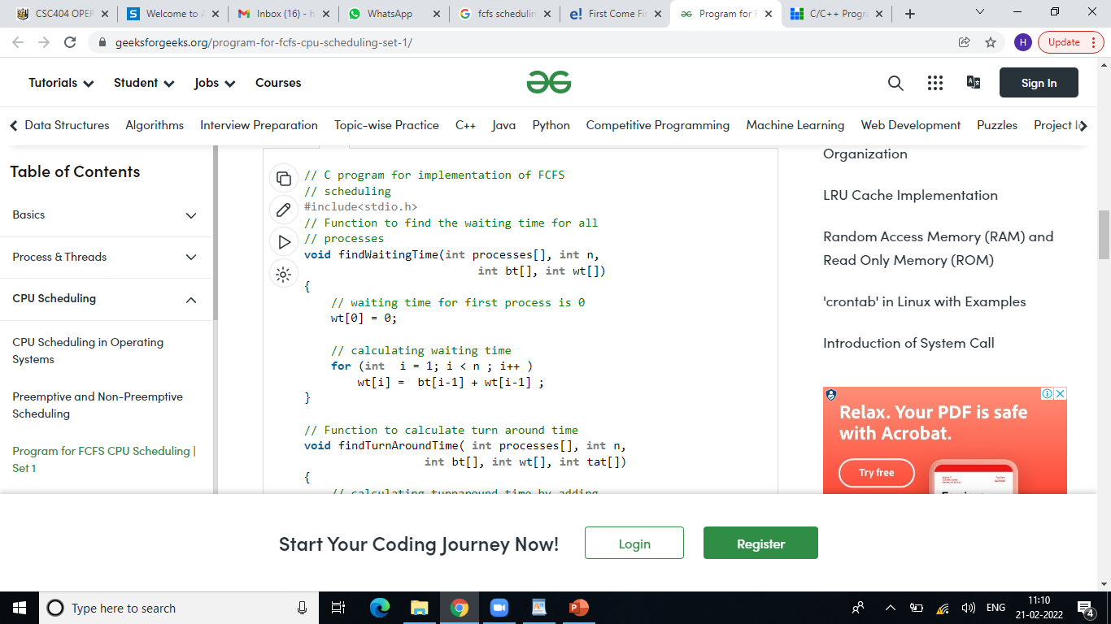


Slide 5
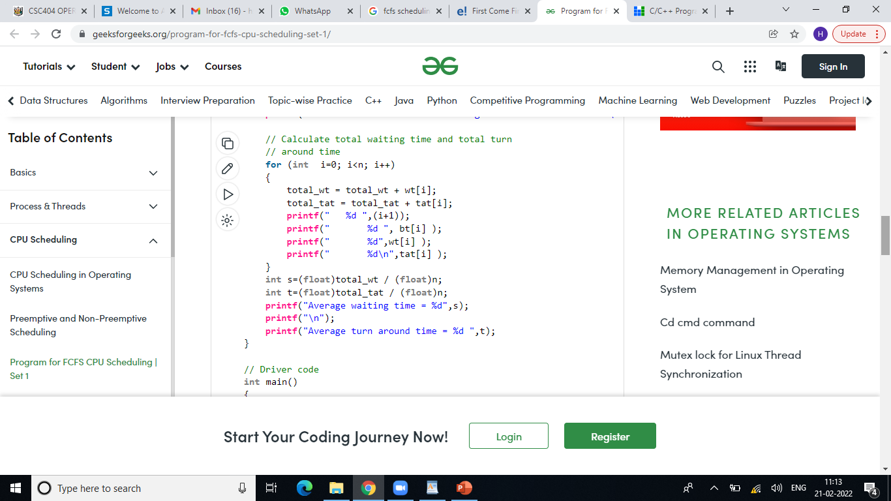
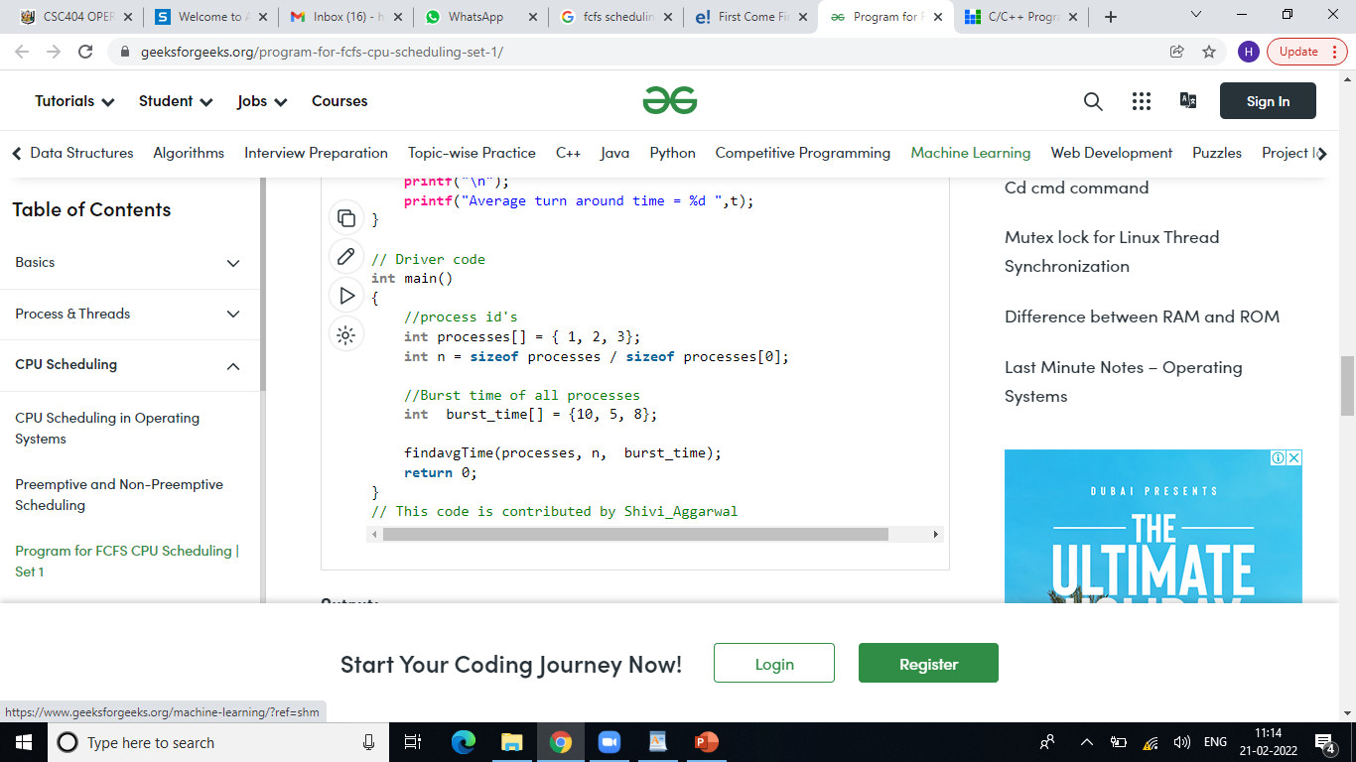

Slide 6
Shortest Job First Scheduling in C Programming
Shortest job first(SJF) is a scheduling algorithm, that is used to schedule processes in an operating system.
There are two types of SJF
Pre-emptive SJF
Non-Preemptive SJF

Slide 7
#include<stdio.h>
int main()
{
int bt[20],p[20],wt[20],tat[20],i,j,n,total=0,pos,temp;
float avg_wt,avg_tat;
printf("Enter number of process:");
scanf("%d",&n);
printf("nEnter Burst Time:n");
for(i=0;i<n;i++)
{
printf("p%d:",i+1);
scanf("%d",&bt[i]);
p[i]=i+1;
}
//sorting of burst times
for(i=0;i<n;i++)
{
pos=i;
for(j=i+1;j<n;j++)
{
if(bt[j]<bt[pos])
pos=j;
}
temp=bt[i];
bt[i]=bt[pos];
bt[pos]=temp;
temp=p[i];
p[i]=p[pos];
p[pos]=temp;
}
wt[0]=0;
for(i=1;i<n;i++)
{
wt[i]=0;
for(j=0;j<i;j++)
wt[i]+=bt[j];
total+=wt[i];
}
avg_wt=(float)total/n;
total=0;
printf("nProcesst Burst Time tWaiting TimetTurnaround Time");
for(i=0;i<n;i++)
{
tat[i]=bt[i]+wt[i];
total+=tat[i];
printf("np%dtt %dtt %dttt%d",p[i],bt[i],wt[i],tat[i]);
}
avg_tat=(float)total/n;
printf("nnAverage Waiting Time=%f",avg_wt);
printf("nAverage Turnaround Time=%fn",avg_tat);
}

Slide 8
burst_time[9] = 9999;
for(time = 0; count != limit; time++)
{
smallest = 9;
for(i = 0; i < limit; i++)
{
if(arrival_time[i] <= time && burst_time[i] < burst_time[smallest] && burst_time[i] > 0)
{
smallest = i;
}
}
burst_time[smallest]--;
if(burst_time[smallest] == 0)
{
count++;
end = time + 1;
wait_time = wait_time + end - arrival_time[smallest] - temp[smallest];
turnaround_time = turnaround_time + end - arrival_time[smallest];
}
}
average_waiting_time = wait_time / limit;
average_turnaround_time = turnaround_time / limit;
printf("nnAverage Waiting Time:t%lfn", average_waiting_time);
printf("Average Turnaround Time:t%lfn", average_turnaround_time);
return 0;
}
#include <stdio.h>
int main()
{
int arrival_time[10], burst_time[10], temp[10];
int i, smallest, count = 0, time, limit;
double wait_time = 0, turnaround_time = 0, end;
float average_waiting_time, average_turnaround_time;
printf("nEnter the Total Number of Processes:t");
scanf("%d", &limit);
printf("nEnter Details of %d Processesn", limit);
for(i = 0; i < limit; i++)
{
printf("nEnter Arrival Time:t");
scanf("%d", &arrival_time[i]);
printf("Enter Burst Time:t");
scanf("%d", &burst_time[i]);
temp[i] = burst_time[i];
}

Slide 9
Round Robin Scheduling in C Programming
We first have a queue where the processes are arranged in first come first serve order.
A quantum value is allocated to execute each process.
The first process is executed until the end of the quantum value. After this, an interrupt is generated, and the state is saved.
The CPU then moves to the next process and the same method is followed.
Same steps are repeated till all the processes are over.

Slide 10
#include<stdio.h>
int main()
{
int i, limit, total = 0, x, counter = 0, time_quantum;
int wait_time = 0, turnaround_time = 0, arrival_time[10], burst_time[10], temp[10];
float average_wait_time, average_turnaround_time;
printf("nEnter Total Number of Processes:t");
scanf("%d", &limit);
x = limit;
for(i = 0; i < limit; i++)
{
printf("nEnter Details of Process[%d]n", i + 1);
printf("Arrival Time:t");
scanf("%d", &arrival_time[i]);
printf("Burst Time:t");
scanf("%d", &burst_time[i]);
temp[i] = burst_time[i];
}
printf("nEnter Time Quantum:t");
scanf("%d", &time_quantum);
printf("nProcess IDttBurst Timet Turnaround Timet Waiting Timen");
for(total = 0, i = 0; x != 0;)
{
if(temp[i] <= time_quantum && temp[i] > 0)
{
total = total + temp[i];
temp[i] = 0;
counter = 1;
}
else if(temp[i] > 0)
{
temp[i] = temp[i] - time_quantum;
total = total + time_quantum;
}
if(temp[i] == 0 && counter == 1)
{
x--;
printf("nProcess[%d]tt%dtt %dttt %d", i + 1, burst_time[i], total - arrival_time[i], total - arrival_time[i] - burst_time[i]);
wait_time = wait_time + total - arrival_time[i] - burst_time[i];
turnaround_time = turnaround_time + total - arrival_time[i];
counter = 0;
}
if(i == limit - 1)
{
i = 0;
}
else if(arrival_time[i + 1] <= total)
{
i++;
}
else
{
i = 0;
}
}
average_wait_time = wait_time * 1.0 / limit;
average_turnaround_time = turnaround_time * 1.0 / limit;
printf("nnAverage Waiting Time:t%f", average_wait_time);
printf("nAvg Turnaround Time:t%fn", average_turnaround_time);
return 0;
}

